Slide 1
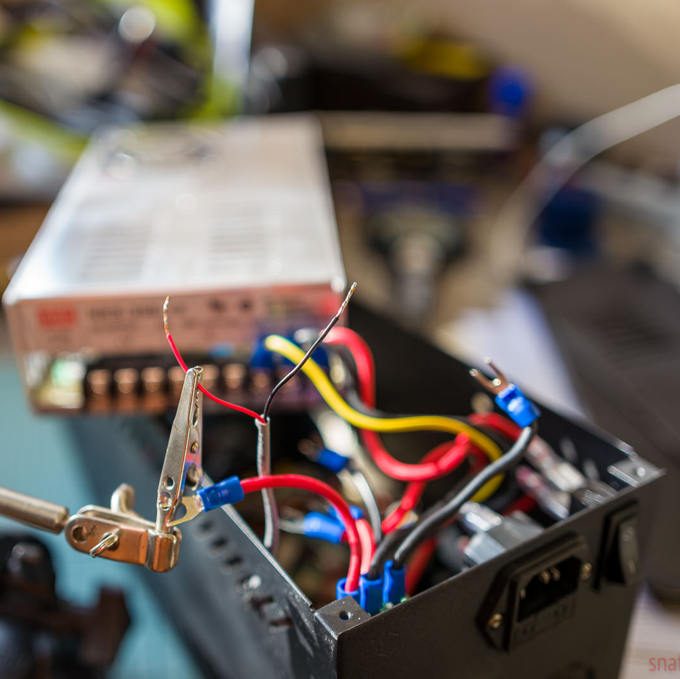
Power, Energy and Ohm's Law

Slide 2
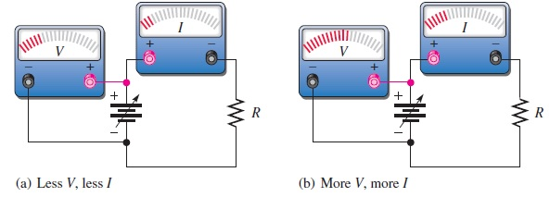
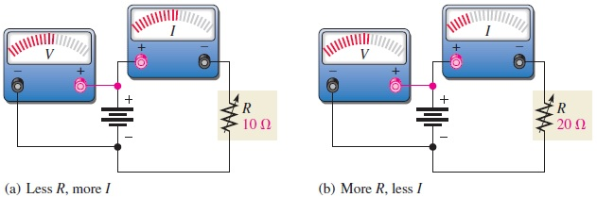
Ohm's Law
Ohm’s law states that current is directly proportional to voltage and inversely proportional to resistance.
V = IR
where I is current in amperes (A), V is voltage in volts (V), and R is resistance in ohms Ω

Slide 3
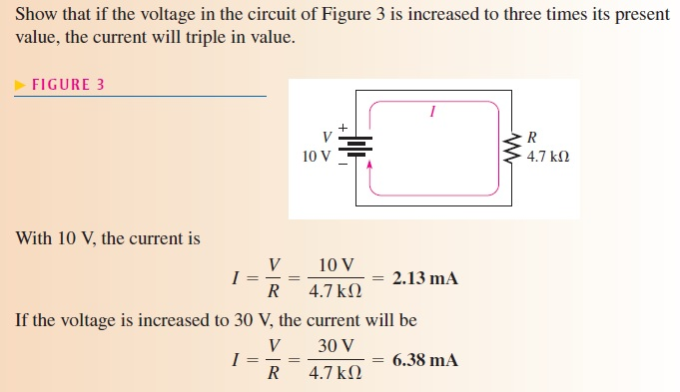
The Linear Relationship of Current and Voltage
In resistive circuits, current and voltage are linearly proportional. Linear means that if one of the quantities is increased or decreased by a certain percentage, the other will increase or decrease by the same percentage, assuming that the resistance is constant in value

Slide 4
The Inverse Relationship of Current and Resistance
current varies inversely with resistance as expressed by Ohm’s law. When the resistance is reduced, the current goes up; when the resistance is increased, the current goes down. For example, if the source voltage is held constant and the resistance is halved, the current doubles in value; when the resistance is doubled, the current is reduced by half.
I = V/R

Slide 5
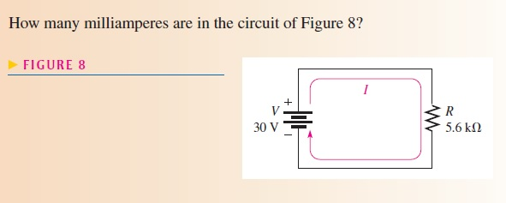
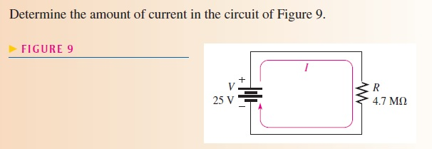
Ohm's Law problems

Slide 6
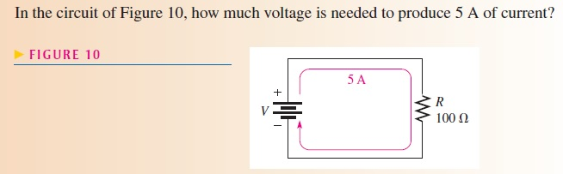
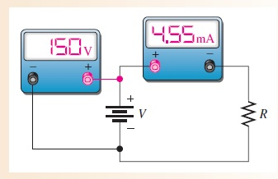
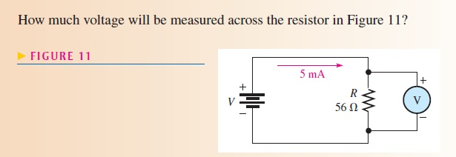

Slide 7
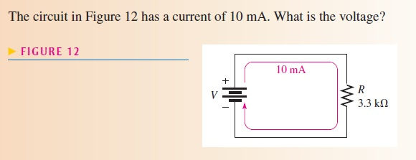
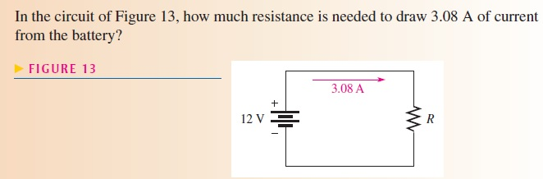

Slide 8
Energy and Power
Energy is the ability to do work, and power is the rate at which energy is used. Power (P) is a certain amount of energy (W) used in a certain length of time (t), expressed as follows:
P = W/t
where P is power in watts (W), W is energy in joules (J), and t is time in seconds (s).
One watt (W) is the amount of power when one joule of energy is used in one second.
Amounts of power much less than one watt are common in certain areas of electronics. milliwatts (mW), microwatts (µW) and even picowatts (pW) are commonly found in some applications.
In the electrical utilities field, kilowatts (kW) and megawatts (MW) are common units.
Electric motors are commonly rated in horsepower (hp) where 1hp = 746W
power utilized over a period of time represents energy consumption. If you multiply power in watts and time in seconds, you have energy in joules, symbolized by W.
W = Pt

Slide 9
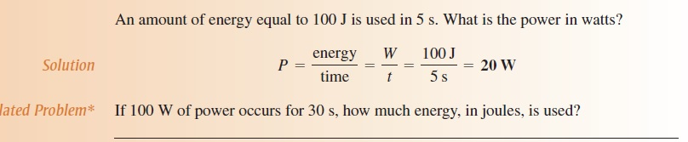

mW
µW
MW
kW

Slide 10
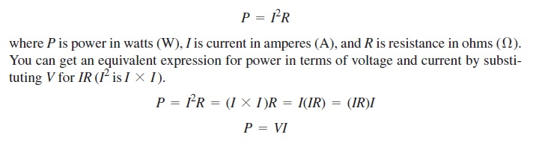
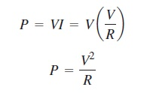
POWER IN AN ELECTRIC CIRCUIT
When there is current through resistance, the collisions of the electrons produce heat as a result of the conversion of electrical energy. The amount of power dissipated in an electric circuit is dependent on the amount of resistance and on the amount of current, expressed as follows:

Slide 11
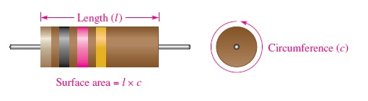
RESISTOR POWER RATINGS
a resistor gives off heat when there is current through it. The limit to the amount of heat that a resistor can give off is specified by its power rating.
The power rating is the maximum amount of power that a resistor can dissipate without being damaged by excessive heat buildup. The power rating is not related to the ohmic value (resistance) but rather is determined mainly by the physical composition, size, and shape of the resistor.
When the power in a resistor is greater than its rating, the resistor will become excessively hot. As a result, the resistor may burn open or its resistance value may change.

Slide 12
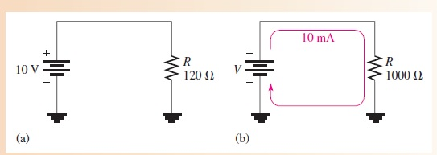
RESISTOR POWER RATINGS cont...

Slide 13
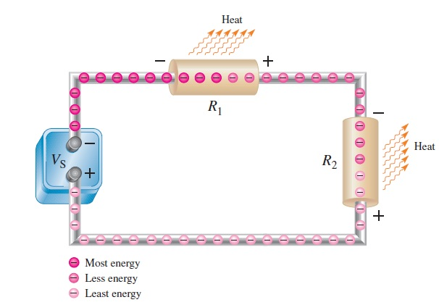
ENERGY CONVERSION AND VOLTAGE DROP IN RESISTANCE

Slide 14
The Kilowatt-hour (kWh) Unit of Energy
Since power is expressed in watts and time in seconds, units of energy called the watt-second (Ws), watt-hour (Wh), and kilowatt-hour (kWh) can be used.
When you pay your electric bill, you are charged on the basis of the amount of energy you use, not the power. Because power companies deal in huge amounts of energy, the most practical unit is the kilowatt-hour.
You use a kilowatt-hour of energy when you use one thousand watts of power for one hour.
a 100 W light bulb burning for 10 h uses 1 kWh of energy.
W = Pt = (100 W)(10 h) = 1000 Wh = 1 kWh

Slide 15
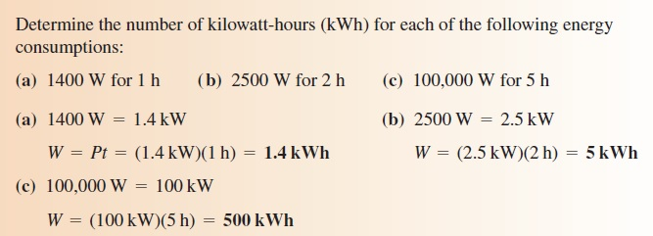
How many kilowatt-hours are used by a 250 W bulb burning for 8 h?

